Slide 1
Graph Fundamentals

Slide 2
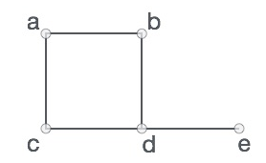
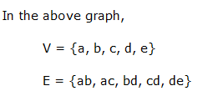
Graph
A graph is a collection of nodes called vertices and collection of segments called line or edges
A graph is a pictorial representation of a set of objects where some pairs of objects are connected by links
Formally, a graph is a pair of sets (V, E), where V is the set of vertices and E is the set of edges, connecting the pairs of vertices. Take a look at the following graph

Slide 3
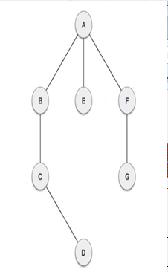
Definitions
Vertex − Each node of the graph is represented as a vertex. labeled circle represents vertices. So A to G are vertices
Edge − Edge represents a path between two vertices or a line between two vertices. lines from A to B, B to C and so on represents edges
Adjacency − Two node or vertices are adjacent if they are connected to each other through an edge. B is adjacent to A, C is adjacent to B and so on
Path − Path represents a sequence of edges between two vertices. In example given below, ABCD represents a path from A to D

Slide 4
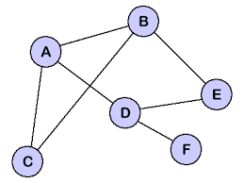
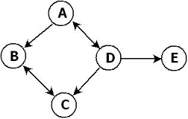
Definitions
Cycle: A cycle is path that consists of at least three vertices that starts and end at same vertex. Here ABC,ABDE are cycle
Loop: A special case of cycle in which a single arc begins and end with the same vertex
Directed graph or digraph: each edge has direction to its successors
Undirected Graph: No direction on any line
Connected Graph: Two vertices are connected if there is a path between them. A graph is said to be connected if ignoring direction there is a path from any vertex to any other vertex

Slide 5
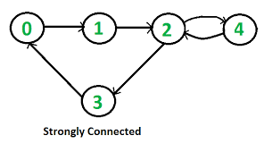
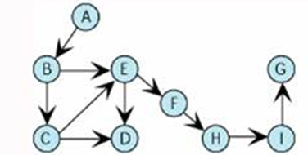
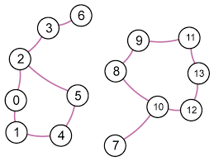
Definitions
Strongly Connected: A directed graph is strongly connected if there is a path from each vertex to other vertex
Weakly connected : A directed graph is weakly connected if at least two vertices are not connected
Disjoint Graph: if graph is not connected

Slide 6

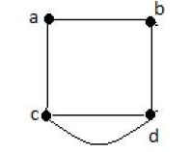
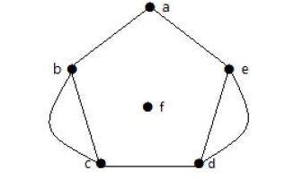
Graph Fundamentals
Parallel Edges
In a graph, if a pair of vertices is connected by more than one edge, then those edges are called parallel edges.
In the above graph, ‘a’ and ‘b’ are the two vertices which are connected by two edges ‘ab’ and ‘ab’ between them. So it is called as a parallel edge.
Multi Graph
A graph having parallel edges is known as a Multigraph.
In the following graph, there are five edges ‘ab’, ‘ac’, ‘cd’, ‘cd’, and ‘bd’. Since ‘c’ and ‘d’ have two parallel edges between them, it a Multigraph.

Slide 7
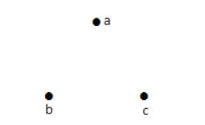

Types of Graphs
Null Graph: A graph having no edges is called a Null Graph.
In the above graph, there are three vertices named ‘a’, ‘b’, and ‘c’, but there are no edges among them. Hence it is a Null Graph.
Trivial Graph : A graph with only one vertex is called a Trivial Graph.
In the above shown graph, there is only one vertex ‘a’ with no other edges. Hence it is a Trivial graph.

Slide 8
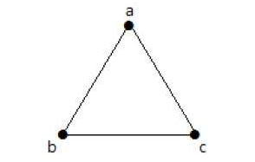
Types of Graphs
Simple Graph: A graph with no loops and no parallel edges is called a simple graph.
The maximum number of edges possible in a single graph with ‘n’ vertices is n(n – 1)/2.
The number of simple graphs possible with ‘n’ vertices 2^{n(n-1)/2}
The maximum number of edges with n=3 vertices −
n(n–1)/2 = 3(3–1)/2 = 6/2 = 3 edges
The maximum number of simple graphs with n=3 vertices −
2^{n(n-1)/2} = 2^{3(3-1)/2} = 2³ = 8

Slide 9
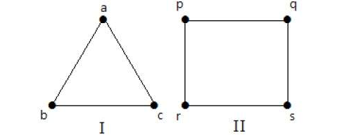
Types of Graphs
Regular Graph
A graph G is said to be regular, if all its vertices have the same degree. In a graph, if the degree of each vertex is ‘k’, then the graph is called a ‘k-regular graph’.
In both the graphs, all the vertices have degree 2. They are called 2-Regular Graphs.

Slide 10
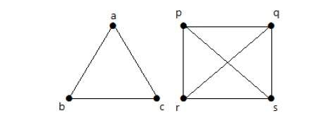
Types of Graphs
Complete Graph
In the graph, a vertex should have edges with all other vertices, then it called a complete graph. A simple graph with ‘n’ mutual vertices is called a complete graph and it is denoted by ‘Kn’.
In other words, if a vertex is connected to all other vertices in a graph, then it is called a complete graph
In the above graphs, each vertex in the graph is connected with all the remaining vertices in the graph except by itself.

Slide 11
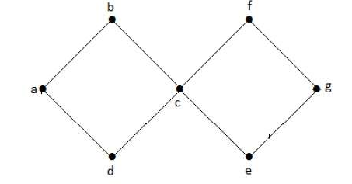
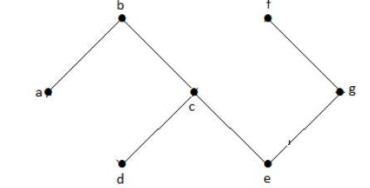
Types of Graphs
Cyclic Graph
A graph with at least one cycle is called a cyclic graph.
Acyclic Graph
A graph with no cycles is called an acyclic graph.

Slide 12
Types of Graphs
Cyclic Graph
A graph with at least one cycle is called a cyclic graph.
Acyclic Graph
A graph with no cycles is called an acyclic graph.

Slide 13
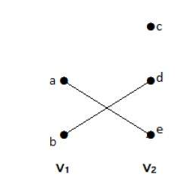
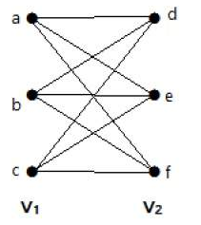
Types of Graphs
Bipartite Graph
Vertex set can be partitioned into two independent sets
A Bipartite graph has two sets of vertices, let us say, V₁ and V₂, and if an edge is drawn, it should connect any vertex in set V₁ to any vertex in set V₂.
Complete Bipartite Graph
A bipartite graph ‘G’, G = (V, E) with partition V = {V₁, V₂} is said to be a complete bipartite graph if every vertex in V₁ is connected to every vertex of V₂.

Slide 14
Types of Graphs
If |V₁| = m and |V₂| = n, then the complete bipartite graph is denoted by K_{m, n}
K_{m,n} has (m+n) vertices and (mn) edges.
K_{m,n} is a regular graph if m=n.
In general, a complete bipartite graph is not a complete graph.
K_{m,n} is a complete graph if m=n=1.
The maximum number of edges in a bipartite graph with n vertices is
[n² /4 ]
If n=10, k5, 5= ⌊ n² 4 ⌋ = ⌊ 10² 4 ⌋ = 25
Similarly K6, 4=24
K7, 3=21
K8, 2=16
K9, 1=9

Slide 15
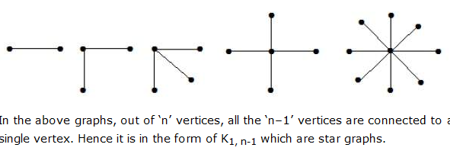
Types of Graphs
Star Graph
A complete bipartite graph of the form K_{1, n-1} is a star graph with n-vertices. A star graph is a complete bipartite graph if a single vertex belongs to one set and all the remaining vertices belong to the other set.

Slide 16
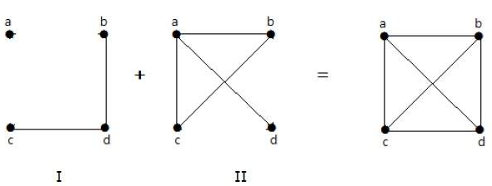
Types of Graphs
Complement of a Graph
Let 'G−' be a simple graph with some vertices as that of ‘G’ and an edge {U, V} is present in 'G−', if the edge is not present in G. It means, two vertices are adjacent in 'G−' if the two vertices are not adjacent in G.
.

Slide 17
Types of Graphs
A combination of two complementary graphs gives a complete graph
If ‘G’ is any simple graph, then |E(G)| + |E('G-')| = |E(K_{n})|, where n = number of vertices in the graph.
Example
Let ‘G’ be a simple graph with 9 vertices and 12 edges, find the number of edges in 'G-'.
|E(G)| + |E('G-')| = |E(K_{n})|
12 + |E('G-')| = 9(9-1) / 2 =
12 + |E('G-')| = 36
|E('G-')| = 24

Slide 18
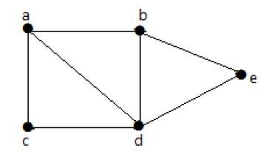
Graph Theory - Connectivity
Connectivity
A graph is said to be connected if there is a path between every pair of vertex. From every vertex to any other vertex, there should be some path to traverse. That is called the connectivity of a graph.
In the following graph, it is possible to travel from one vertex to any other vertex. For example, one can traverse from vertex ‘a’ to vertex ‘e’ using the path ‘a-b-e’.

Slide 19
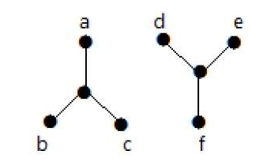
Graph Theory - Connectivity
In the following example, traversing from vertex ‘a’ to vertex ‘f’ is not possible because there is no path between them directly or indirectly. Hence it is a disconnected graph.

Slide 20
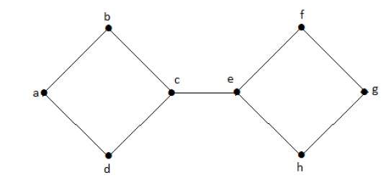
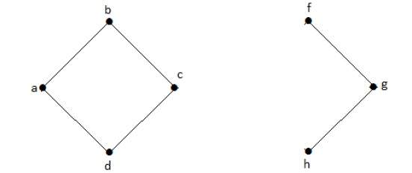
Graph Theory - Connectivity
Cut Vertex
Let ‘G’ be a connected graph. A vertex V ∈ G is called a cut vertex of ‘G’, if ‘G-V’ (Delete ‘V’ from ‘G’) results in a disconnected graph. Removing a cut vertex from a graph breaks it in to two or more graphs.
By removing ‘e’ or ‘c’, the graph will become a disconnected graph.

Slide 21
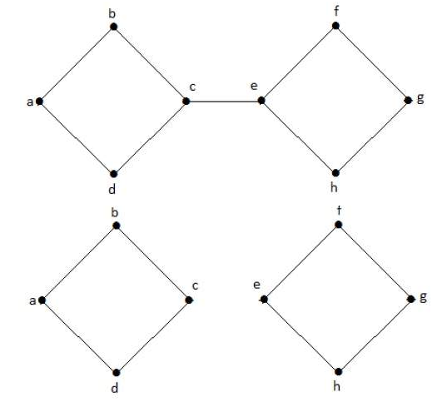
Graph Theory - Connectivity
Cut Edge (Bridge)
Let ‘G’ be a connected graph. An edge ‘e’ ∈ G is called a cut edge if ‘G-e’ results in a disconnected graph.

Slide 22
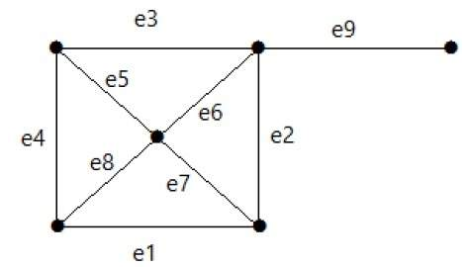
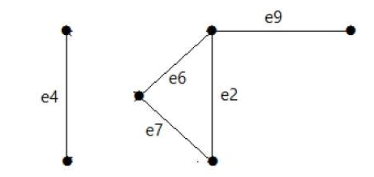
Graph Theory - Connectivity
Cut Set of a Graph
Let ‘G’= (V, E) be a connected graph. A subset E’ of E is called a cut set of G if deletion of all the edges of E’ from G makes G disconnect. Its cut set is E1 = {e1, e3, e5, e8}.
Similarly there are other cut sets that can disconnect the graph −
E2 = {e9} – Smallest cut set of the graph.
E4 = {e3, e4, e5}

Slide 23
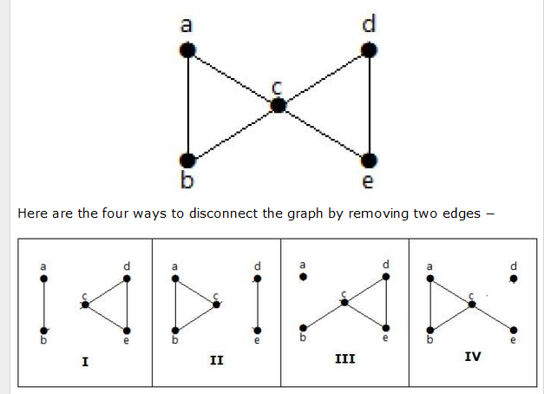
Graph Theory - Connectivity
Edge Connectivity
Let ‘G’ be a connected graph. The minimum number of edges whose removal makes ‘G’ disconnected is called edge connectivity of G.
Notation − λ(G)
If ‘G’ has a cut edge, then λ(G) is 1. (edge connectivity of G.)

Slide 24
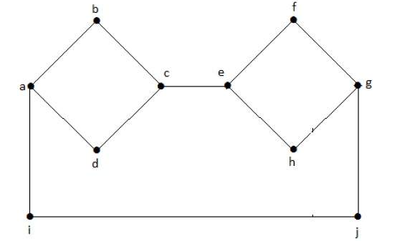
Graph Theory - Connectivity
Vertex Connectivity
Let ‘G’ be a connected graph. The minimum number of vertices whose removal makes ‘G’ either disconnected or reduces ‘G’ in to a trivial graph is called its vertex connectivity.
Notation − K(G)
In the above graph, removing the vertices ‘e’ and ‘i’ makes the graph disconnected.
If G has a cut vertex, then K(G) = 1.

Slide 25
Graph Theory - Isomorphism
Isomorphic Graphs
Two graphs G₁ and G₂ are said to be isomorphic if −
Their number of components (vertices and edges) are same.
Their edge connectivity is retained.
If G₁ ≡ G₂ then −
|V(G₁)| = |V(G₂)|
|E(G₁)| = |E(G₂)|
Degree sequences of G₁ and G₂ are same.
If the vertices {V₁, V₂, .. V_{k}} form a cycle of length K in G₁, then the vertices {f(V₁), f(V₂),… f(V_{k})} should form a cycle of length K in G₂.
All the above conditions are necessary for the graphs G₁ and G₂ to be isomorphic, but not sufficient to prove that the graphs are isomorphic.
(G₁ ≡ G₂) if and only if (G₁− ≡ G₂−) where G₁ and G₂ are simple graphs.
(G₁ ≡ G₂) if the adjacency matrices of G₁ and G₂ are same.
(G₁ ≡ G₂) if and only if the corresponding subgraphs of G₁ and G₂ (obtained by deleting some vertices in G₁ and their images in graph G₂) are isomorphic.

Slide 26
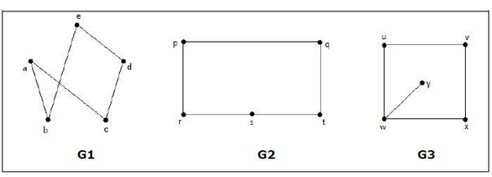
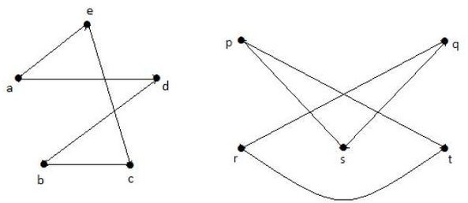
Graph Theory - Isomorphism
In the graph G₃, vertex ‘w’ has only degree 3, whereas all the other graph vertices has degree 2. Hence G₃ not isomorphic to G₁ or G₂.
Taking complements of G₁ and G₂, you have −
Here, (G₁− ≡ G₂−), hence (G₁ ≡ G₂).

Slide 27
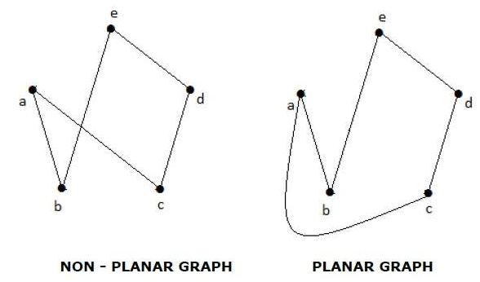
Graph Theory - Isomorphism
Planar Graphs
A graph ‘G’ is said to be planar if it can be drawn on a plane or a sphere so that no two edges cross each other at a non-vertex point.

Slide 28
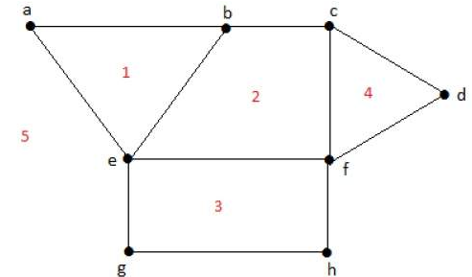
Regions
Every planar graph divides the plane into connected areas called regions.
Degree of a bounded region r = deg(r) = Number of edges enclosing the regions r.
deg(1) = 3 deg(2) = 4 deg(3) = 4 deg(4) = 3 deg(5) = 8

